Slide 1
How to build a PC
Mainboard, storage and cooler

Slide 2


Slide 3
Sockets for microprocessors
Memory slots
Clock generator
Power connectors
Hard drive connectors

Slide 4
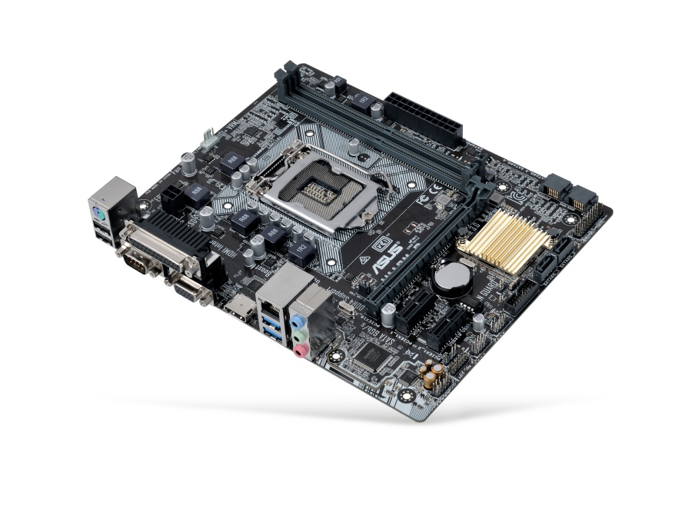
Power connector
CPU socket
Input/Output
Memory slots

Slide 5
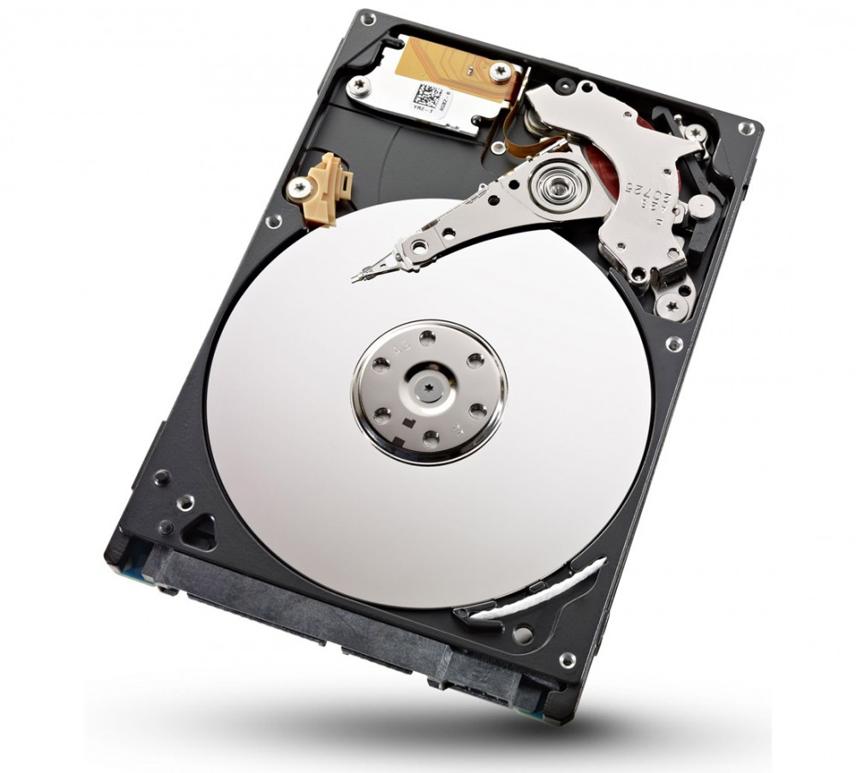
The storage

Slide 6
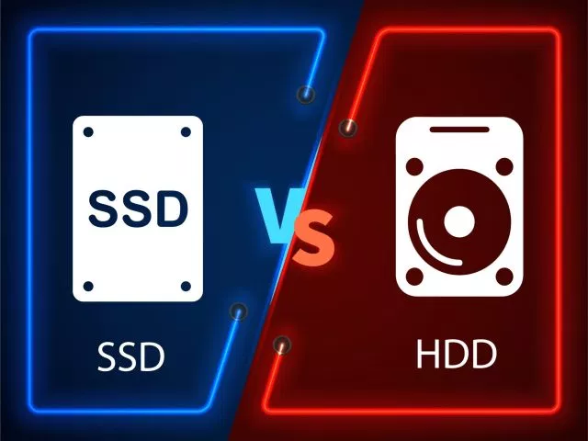

Slide 7
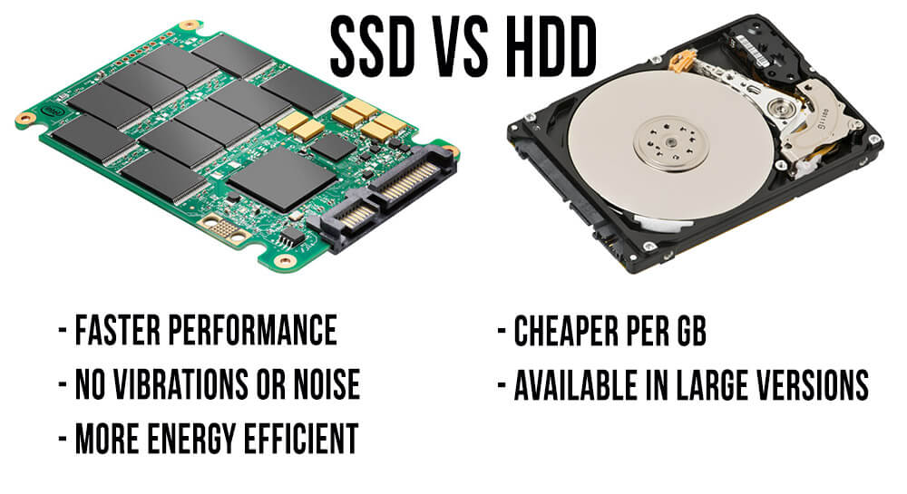

Slide 8
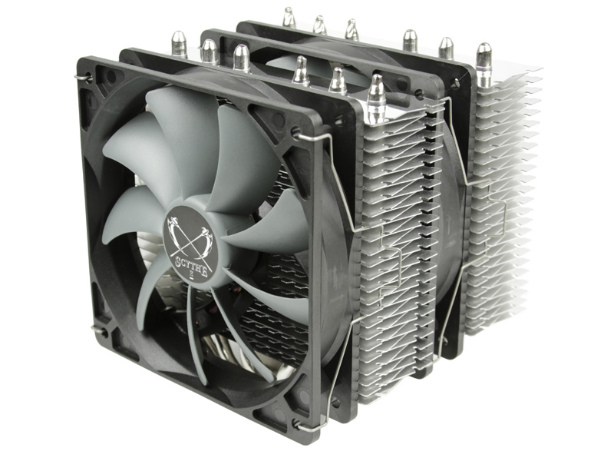
The cooler

Slide 9
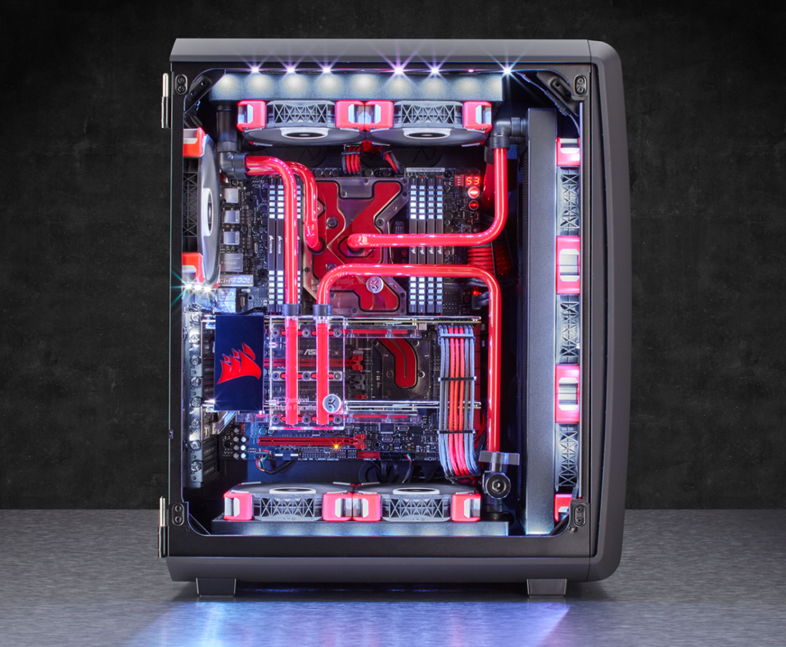

Slide 10
liquid cooling systems
pros:
cons:
more efficient
less noise
quite expensive
Very comlicated to install

Slide 11
CPU
Performs calculations
Consists of electronic circuits
Components:
Control Unit
Arithmetic Logic Unit (ALU)
Floating Point Unit
Caches and Registers

Slide 12
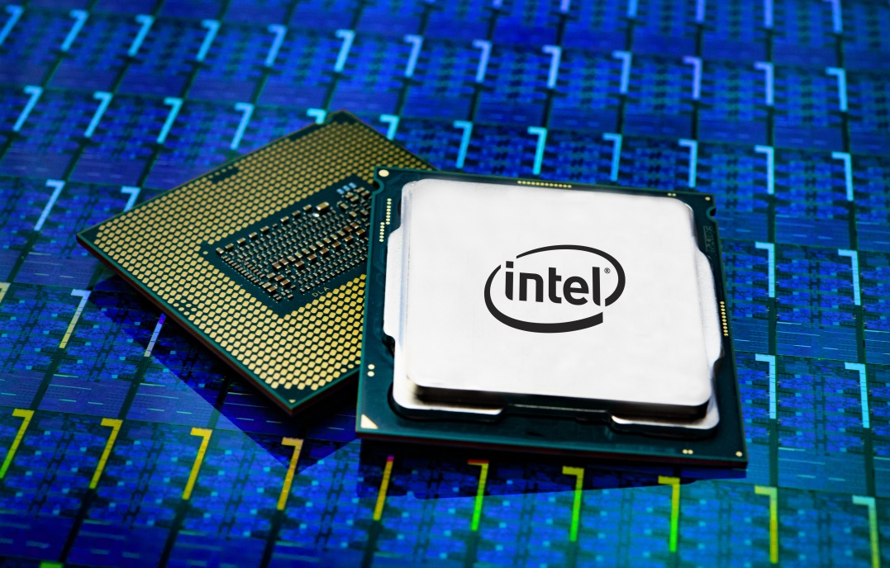
Examples
Intel® Core™ i3 8100
4x 3,60 GHz
129€
Intel® Core™ i7 9700K
8x 3,60 GHz
409€

Slide 13
Assembling
Discharge yourself
Work on a non-metallic surface
Put CPU in position
Install heat sink using cooling paste
Stick to manual

Slide 14
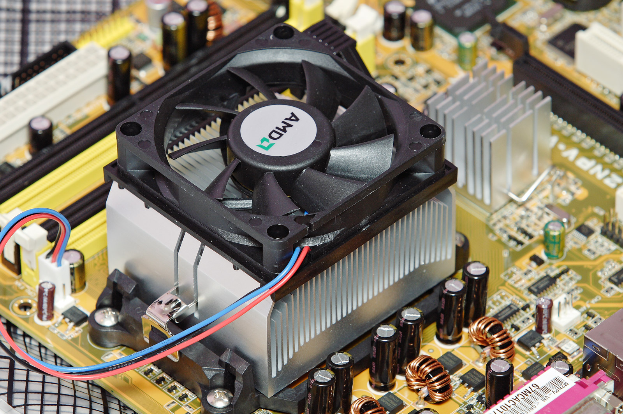
Assembling

Slide 15
RAM
Random Access Memory
Consists of integrated circuits
Stores data and running programs

Slide 16
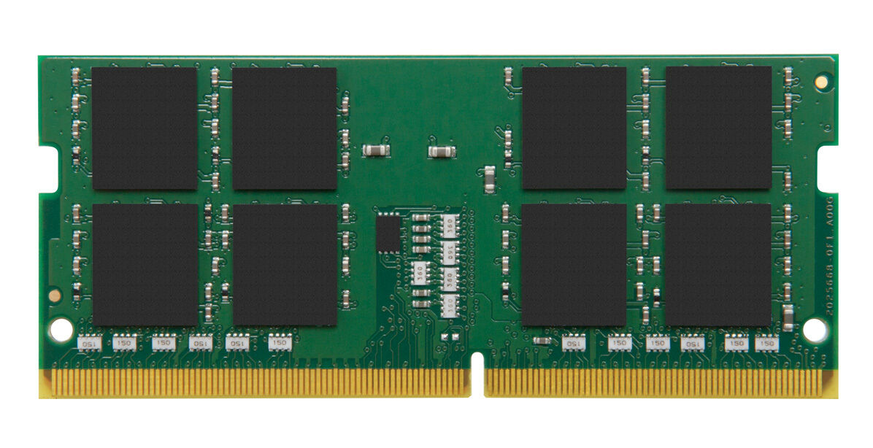
Examples
Kingston ValueRAM
4GB DDR3L-1600
23€
Kingston ValueRAM
16GB DDR4-2400
90€

Slide 17
Assembling
Just put the RAM in the appropriate slot

Slide 18
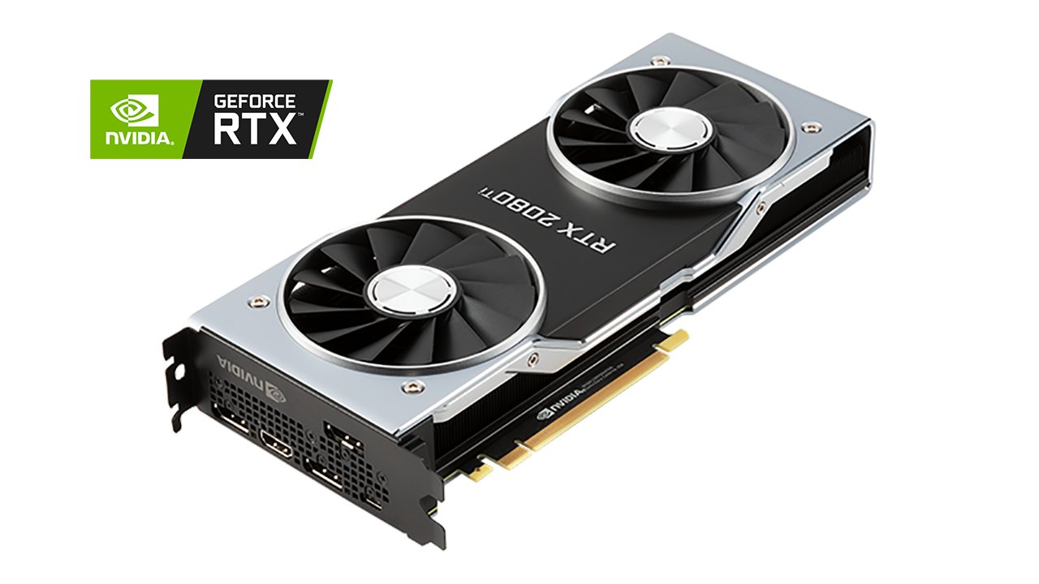
Graphic Cards
Fabian Ansorge

Slide 19
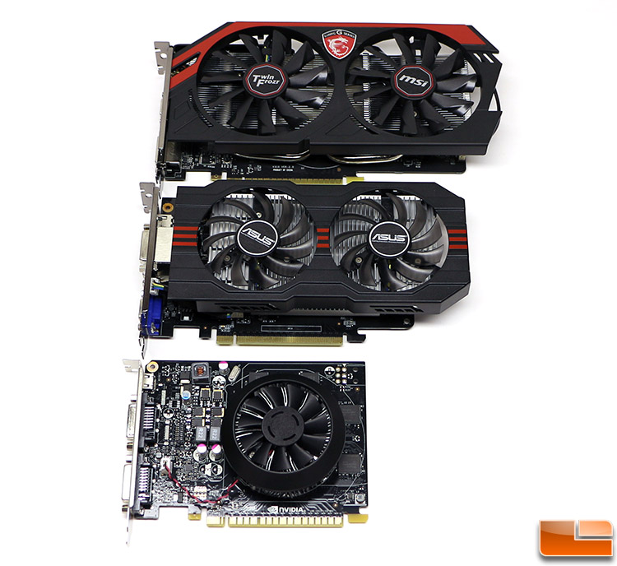
Size

Slide 20
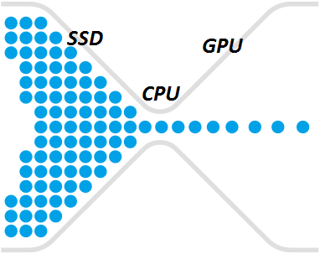
Bottleneck

Slide 21
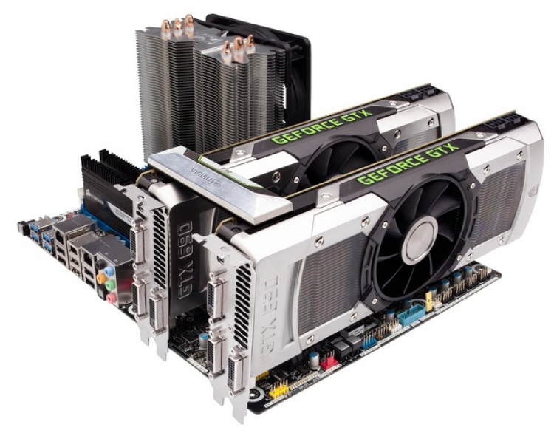
Multi-Card Setup

Slide 22

NVIDEA VS AMD

Slide 23
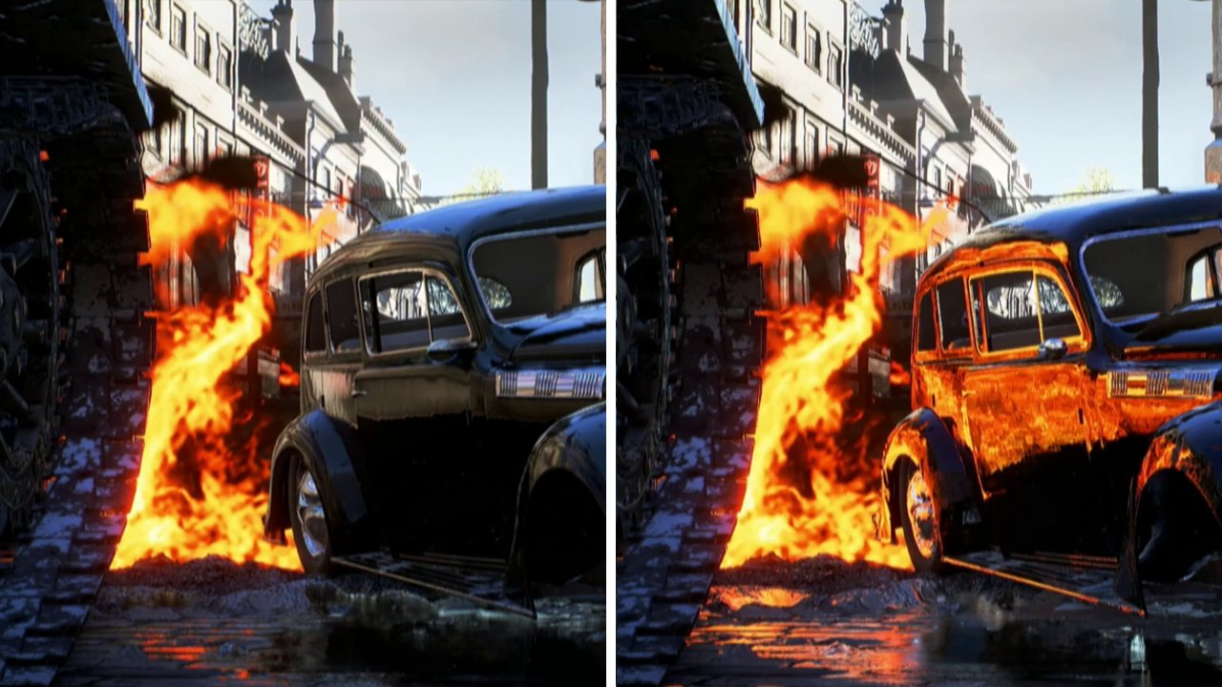
Ray Tracing

Slide 24
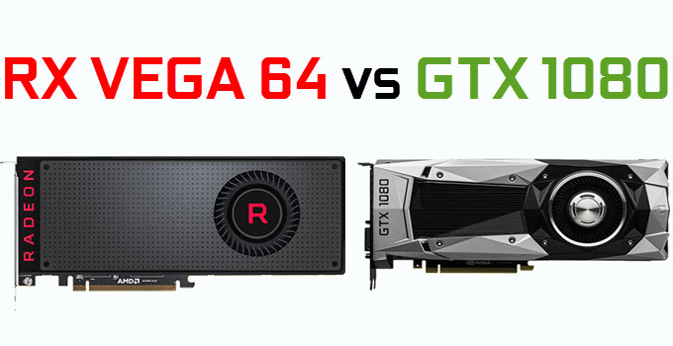
Card Comparison

Slide 25
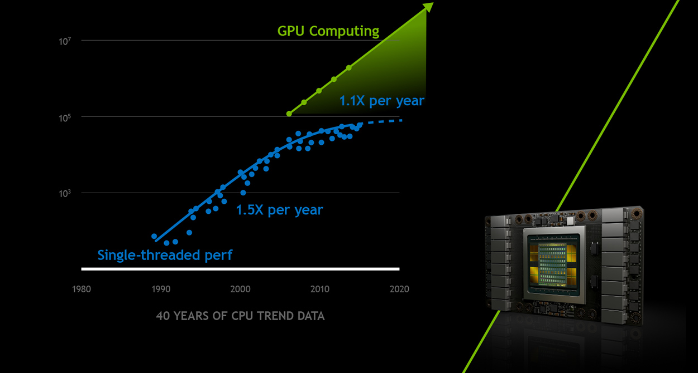
Future?

Slide 26


Slide 27
Thanks for your attention ;)

